Slide 1
GEOG 582 Final Project Wildfire Analysis: Atmospheric Changes and Effects Vijaybhaskar Kothapally MS in Big Data Analytics

Slide 2
Introduction (The Why?)
Global climate change is not a future problem!
Ozone is an important global greenhouse gas, third in line behind carbon dioxide and methane.
Researchers found that smoke from wildfires influences ozone pollution on a global scale.
In this project, We analyze Valley Wildfire that took place in San Diego in 2020, to identify the changes in the atmosphere and how it relates to Ozone formation.

Slide 3
Background (The What?)
Ozone can be good or bad based on where it is found.
Stratosphere – Protects from UV
Ground-Level – Harmful
Tropospheric or ground-level ozone is created by chemical reactions between nitrogen oxides (NOx) and volatile organic compounds (VOC).
We use weather data and daily data of pollutants like CO, SO2, NO2, Particulate matter, and Lead to identify correlations with Ozone concentration.

Slide 4
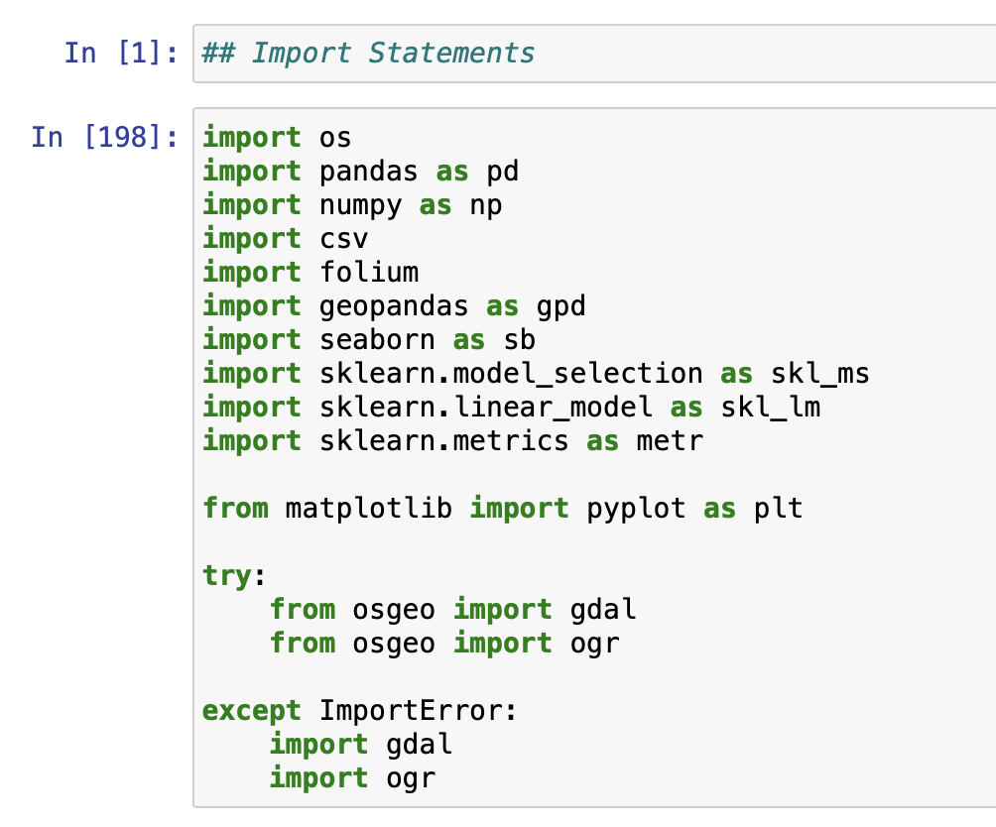

The Data (The How?)
California Wildfire Perimeters 2020 ESRI Shapefile from ArcGIS Online.
Daily weather and atmospheric pollutants data
from Jan to Dec 2020.
US Environmental Protection Agency.
Cal Fire - Yearly Wildfire Suppression Expenditure Data.

Slide 5
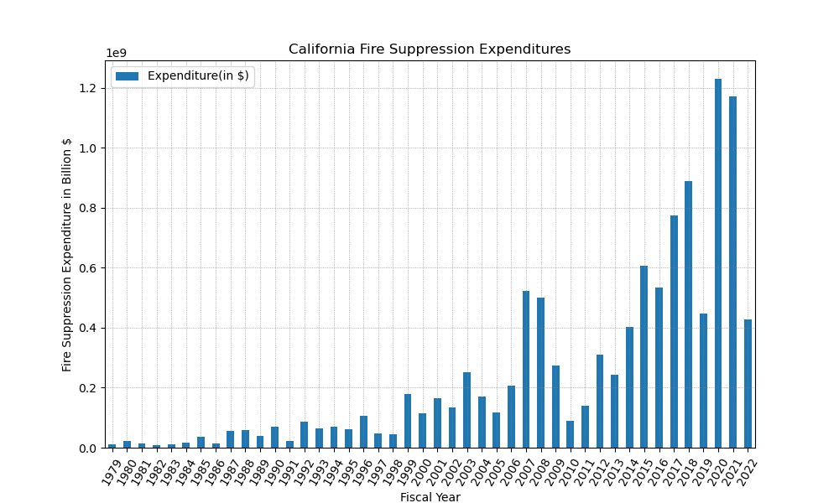
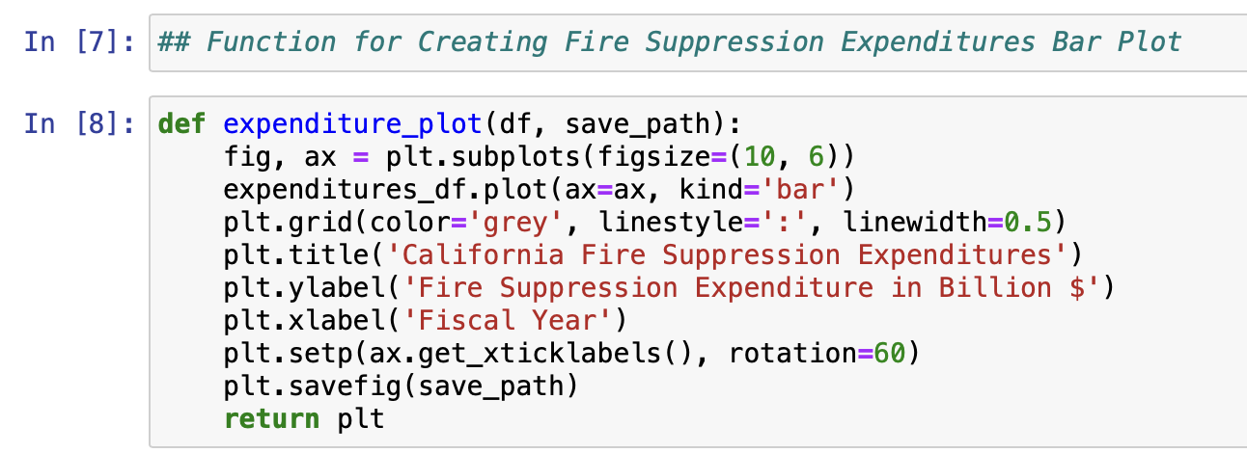
California Wildfires
According to a study done at UCLA, carbon pollution from California’s 2020 wildfires erased 16 years of the state’s greenhouse gas emission cuts.

Slide 6
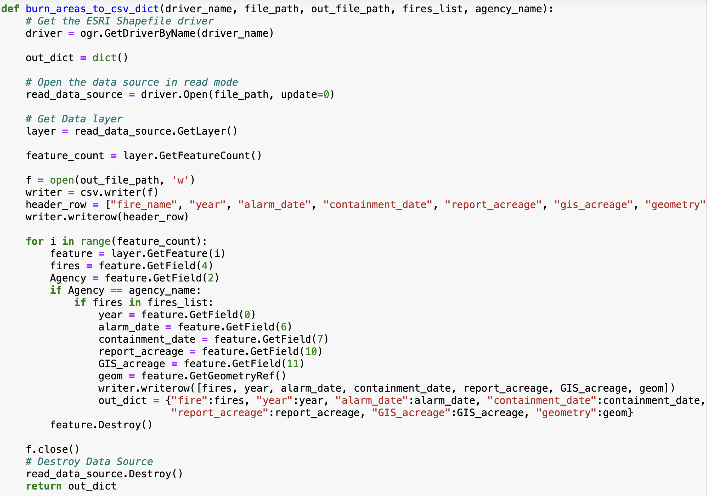
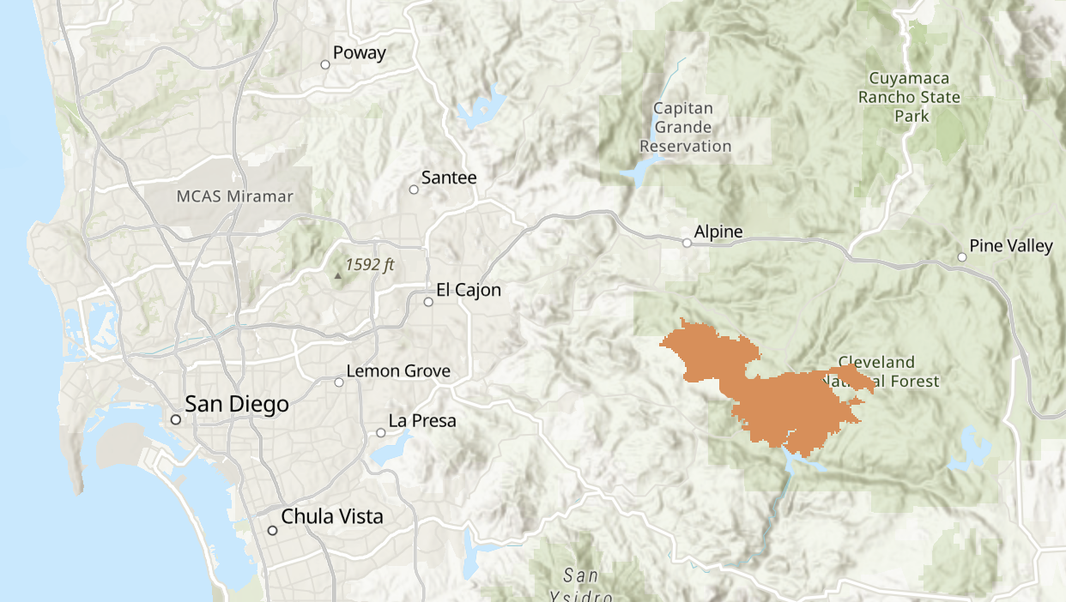
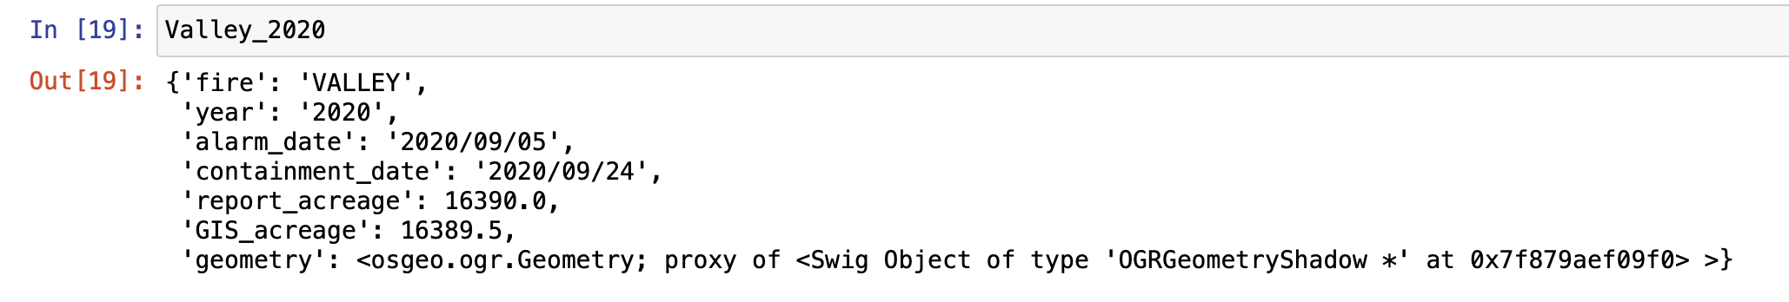
Valley Wildfire
Valley Wildfire 2020, San Diego County

Slide 7
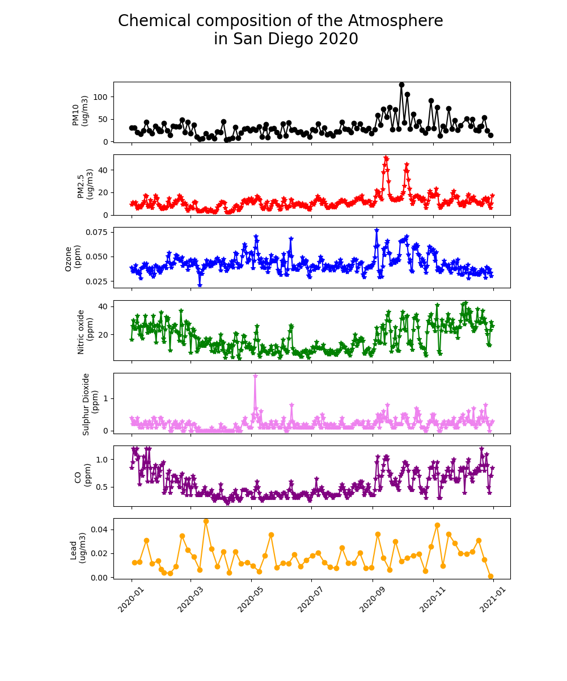
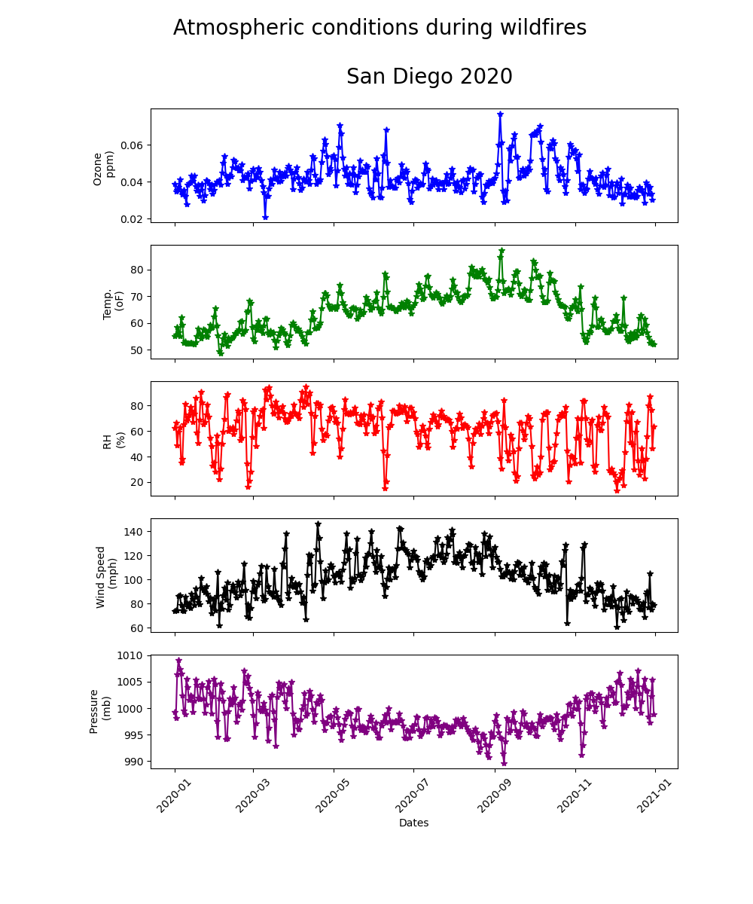

Slide 8
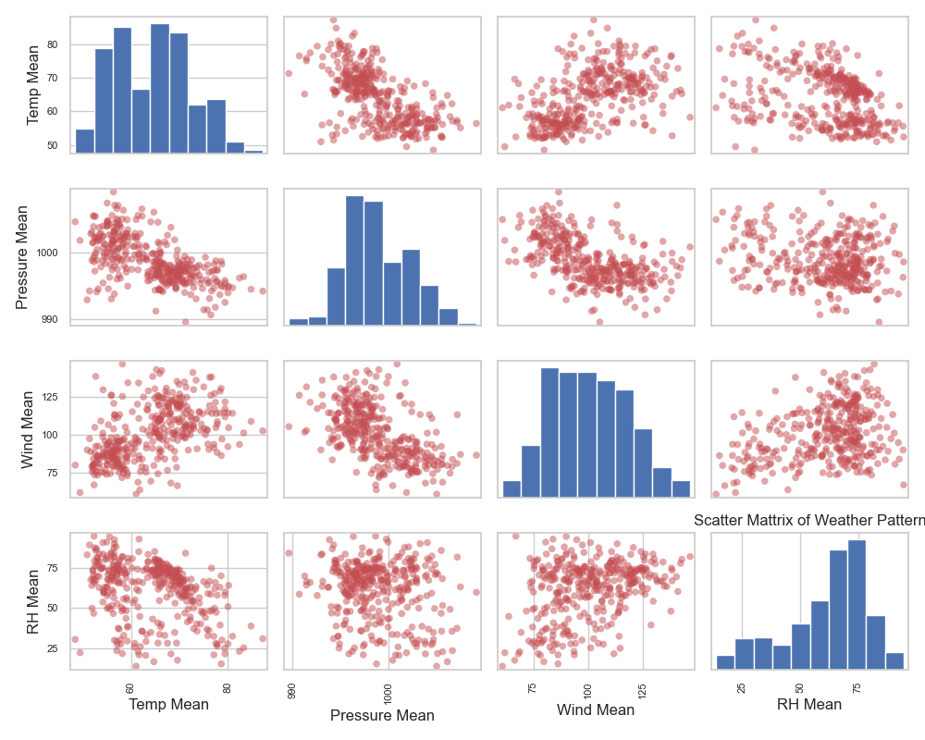
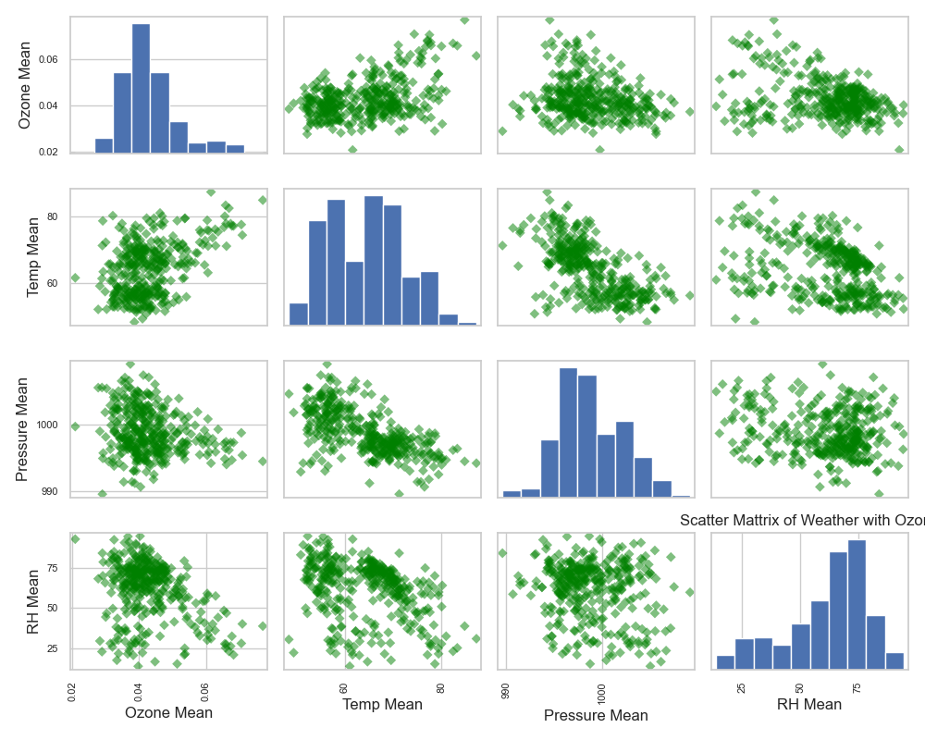
Temperature is inversely proportional to
Pressure and Relative humidity. We now combine this
with Ozone.
From the time series graphs, we can identify that
High temperature, high wind, and low relative
Humidity (dry conditions) has fueled the wildfire.
From the scatter plot, Wind and Relative Humidity
have extreme patterns.

Slide 9
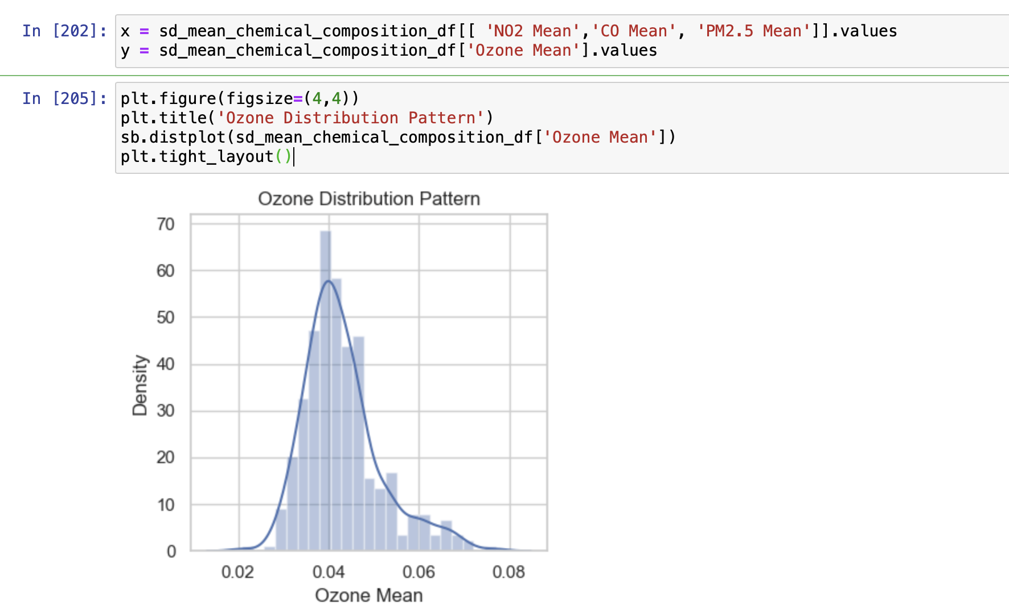
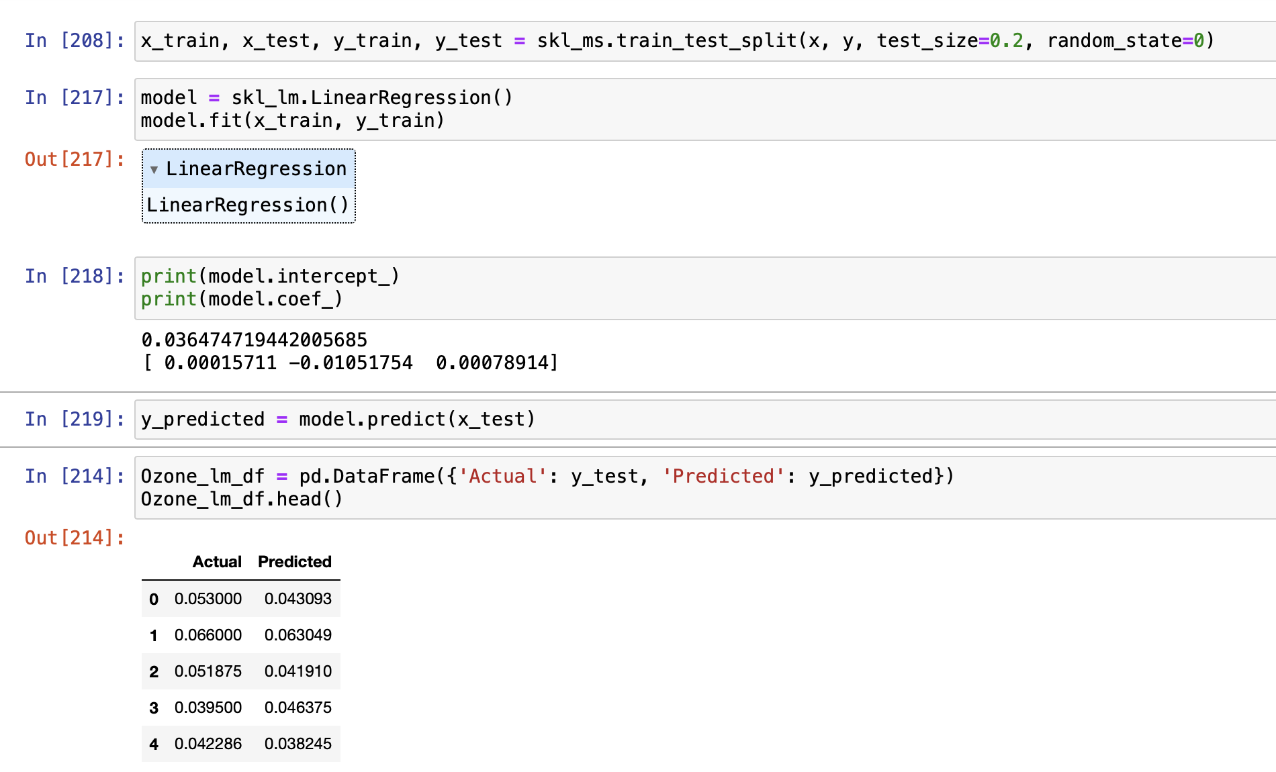
Ozone Prediction Model
Ozone precursors, nitrogen oxides, and volatile organic carbons directly affect the Ozone formation chemistry.
VOC data is not measured at all stations, and daily data is unavailable. So, we use CO, NO2, and PM2.5 for our model.

Slide 10
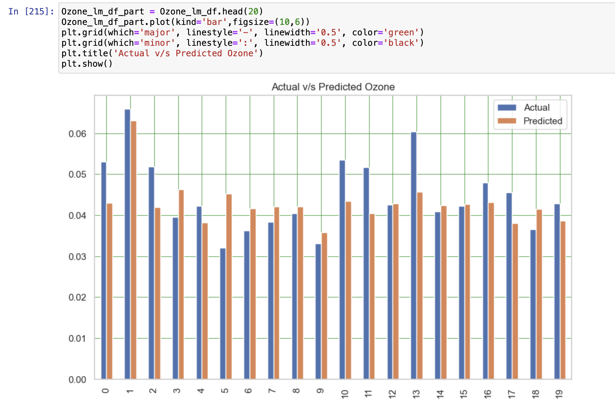
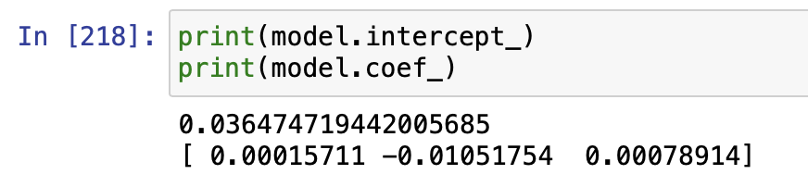
Mean Absolute Error:
0.005033547539219841
Mean Squared Error:
4.251780785006544e-05
Root Mean Squared Error: 0.006520568061914962

Slide 11
Results and Conclusion
Ozone Mean = 0.042966
RMSE = 0.006520568061914962
(0.006520568061914962/0.042966)*100 = 15%
Only 15% could not be predicted from the model, which is still a good fit.
The error can be accounted to extreme weather events like wildfires and rain.
Adding a VOC variable would improve the coefficients.
Temperature, Nitrogen Oxides, Particulate Matter, Carbon Oxides, and VOCs influence Ozone.
Dry Weather is the main reason for fires in San Diego County.
Ozone can aggravate lung diseases such as asthma and chronic bronchitis and increase the frequency of asthma and cardiovascular attacks.

